Slide 1
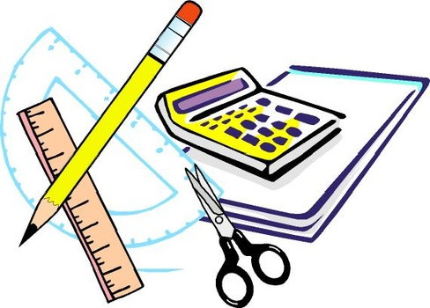
Learning Objective
I will find common multiples of two numbers.
Enter quietly, please be ready with the following on your desk:
Whiteboard
Whiteboard marker
Exercise Book
Pencil, pen, ruler and red pen
Diary
Calculator
Device – charged or borrowed from Library before maths

Slide 2

Learning Objective
CFU
What will we learn today?
CFU
I will find common multiples of two numbers.
How will you know that you are successful?
Success Criteria
At the end of the lesson, I will be able to:
Find the first 10 multiples of a number.
Find the lowest common multiple of 2 numbers.

Slide 3
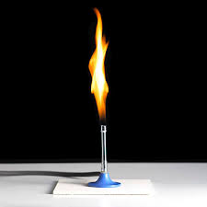
Relevance
Ms Podesta needs her class of 26 students to be divided into groups of 3 or 4 do an experiment. If she only has 7 Bunsen burners, how many groups does she need and how many students in each?
We can use factors and multiples to work this out:
Ms Podesta needs:
5 groups with 4 students and 2 groups of 3 students.

Slide 4

Activate Prior Knowledge
Recognise this?
2, 4, 6, 8, 10, 12…
They are multiples of 2 and they go on forever…
and ever…
and ever…
What are the first 5 multiples of 5?
Where do the multiples of 5 end?

Slide 5
Concept Development
CFU
What is a common multiple?
Common multiples of two numbers are any number that appears in the times table of both of your numbers.
CFU
How do you find a common multiple?
Common Multiples of 3 and 4
CFU
Write out the times tables of the first number.
3
6
9
12
15
18
21
24
27
30
4
8
12
16
20
24
28
32
36
40
What is the first common multiple of 3 and 4?
Write out the times tables of the second number.
The first 2 common multiples of 3 and 4 are 12 and 24.
Highlight any common numbers between the lists.
Clearly write out your answer.

Slide 6
Skill Development
CFU
What is the first step?
Common multiples of two numbers are any number that appears in the times table of both of your numbers.
CFU
What is the second step?
Common Multiples of 2 and 6
CFU
Write out the times tables of the first number.
2
4
6
8
10
12
14
16
18
20
6
12
18
24
30
36
42
48
54
60
How do you find the common multiples?
Write out the times tables of the second number.
The first 3 common multiples of 2 and 6 are 6, 12 and 18.
Highlight any common numbers between the lists.
Clearly write out your answer.

Slide 7
Question
There may be more than one!!
Which of the following are common multiples of 4 and 8?
A: 1
B: 2
C: 8
D: 12
E: 16
F: 24

Slide 8
Concept Development
CFU
What is the Lowest Common Multiple?
The Lowest Common Multiple (LCM) of two numbers is the lowest number that appears in all of the numbers’ times tables.
Lowest Common Multiple of 3 and 5
Write out the times tables of the first number.
3
6
9
12
15
18
21
24
27
30
5
10
15
20
25
30
35
40
45
50
Write out the times tables of the second number.
The LCM of 3 and 5 is 15.
Highlight the first common number between the lists.
Clearly write out your answer.

Slide 9
Skill Development
CFU
How many answers will you get for LCM?
The Lowest Common Multiple (LCM) of two numbers is the lowest number that appears in all of the numbers’ times tables.
Write out the times tables of the first number.
Lowest Common Multiple of 2 and 4
Write out the times tables of the second number.
2
4
6
8
10
12
4
8
12
16
20
24
The LCM of 2 and 4 is 4.
Highlight the first common number between the lists.
Clearly write out your answer.

Slide 10
Skill Development
CFU
What is a LCM?
The Lowest Common Multiple (LCM) of two numbers is the lowest number that appears in all of the numbers’ times tables.
CFU
How many answers will you get for LCM?
Write out the times tables of the first number.
Lowest Common Multiple of 4 and 6
Write out the times tables of the second number.
4
8
12
16
20
24
6
12
18
24
30
36
The LCM of 4 and 6 is 12.
Highlight the first common number between the lists.
Clearly write out your answer.

Slide 11
Question
Which of the following is the LCM of 8 and 10?
A: 1
B: 2
C: 10
D: 40
E: 80
F: 100

Slide 12
Guided Practice
Whiteboards
Find the first
3 common multiples of:
Find the LCM of:
2 and 8
4 and 6
3 and 9
8, 16, 24
5 and 8
4 and 7
3 and 6
40
12, 24, 36
28
9, 18, 27
6

Slide 13
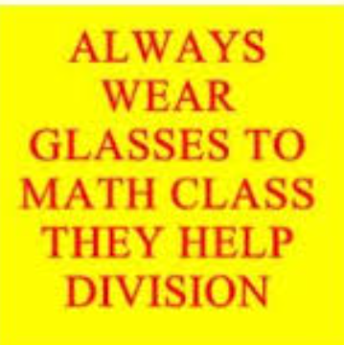
Skill Closure
What have we learnt today?
Lesson Objectives:
I will find common multiples of two numbers.
  How do you find the LCM of two numbers?
Write out the times tables of the first number.
Write out the times tables of the second number.
Highlight the first common number between the lists.
Clearly write out your answer.

Slide 14


Independent Practice
Mathematics Page Layout
Open your textbooks to:
Chapter 2.1
Questions: 4

